Slide 1

润锋科技
RUNFENGKEJI
业务培训-助理相关8项工作
WORK SUMMARY REPORT
Suitable for company promotion, product introduction, development plan, business financing, etc. product introduction, development plan, business financing, etc.

Slide 2
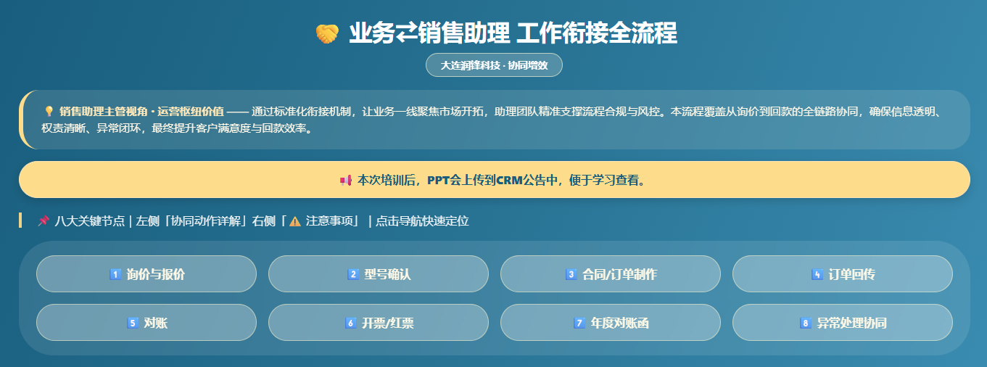

Slide 3
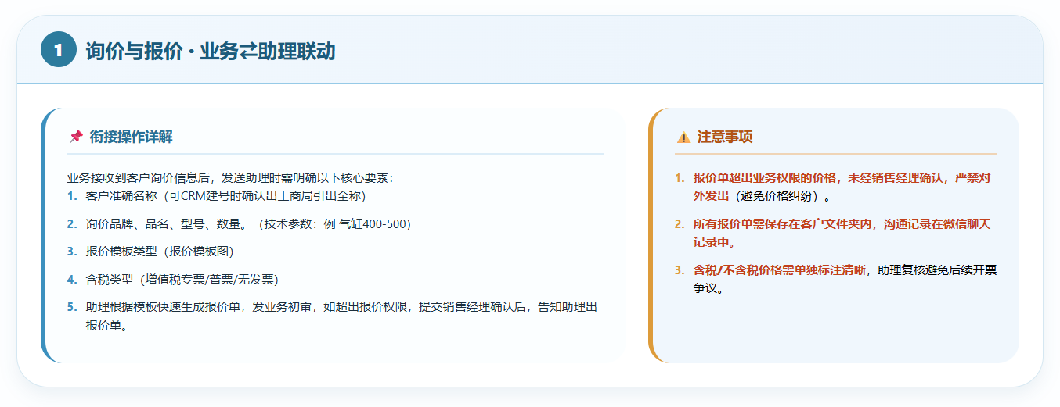

Slide 4
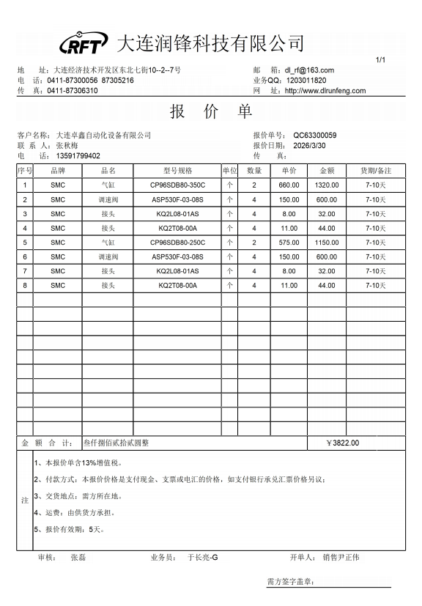

Slide 5
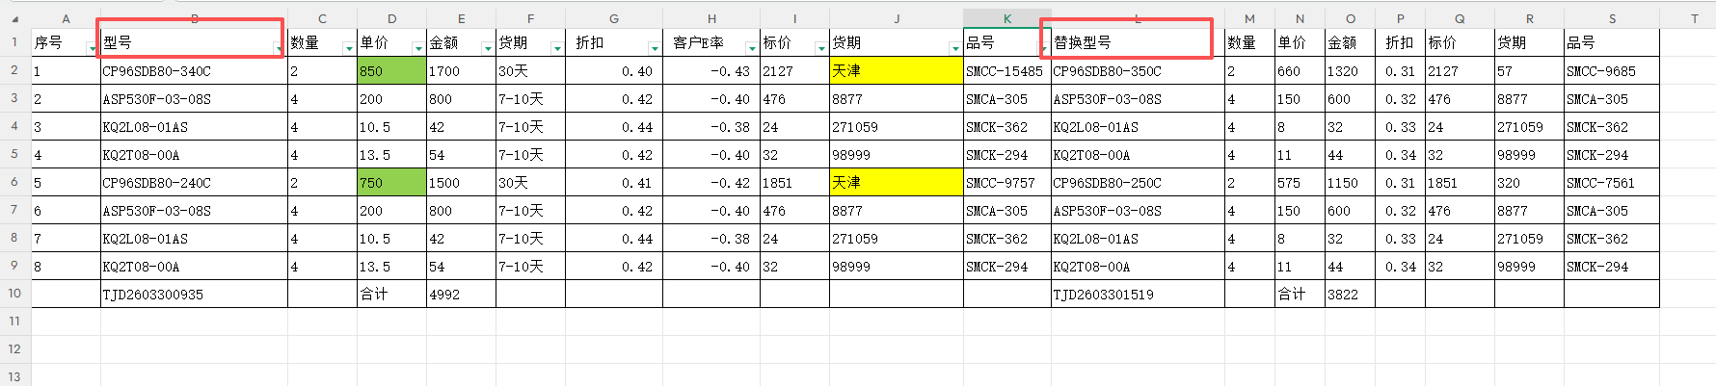
SMC 2次报价明细表 换型、降价

Slide 6

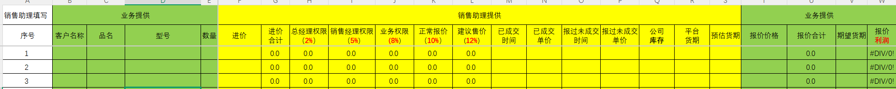

Slide 7

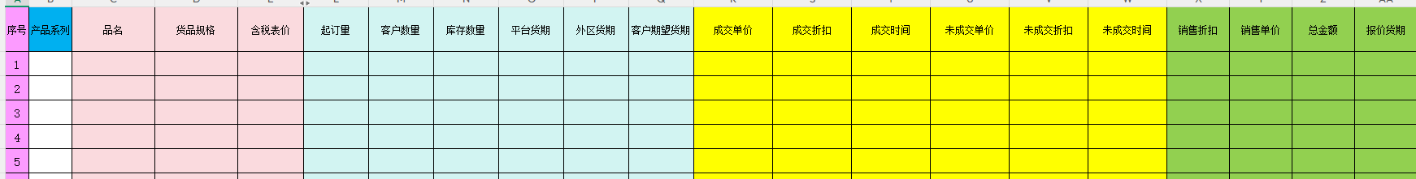

Slide 8
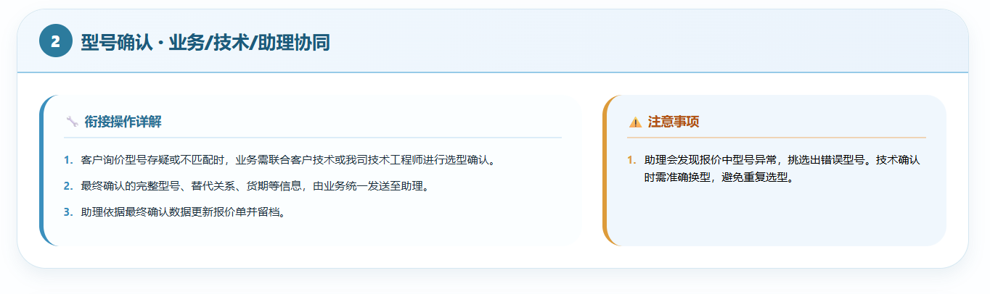

Slide 9
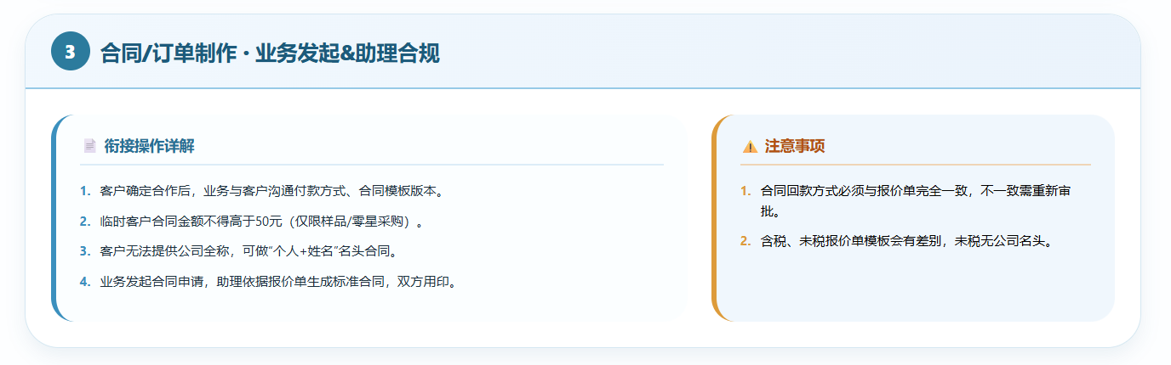

Slide 10
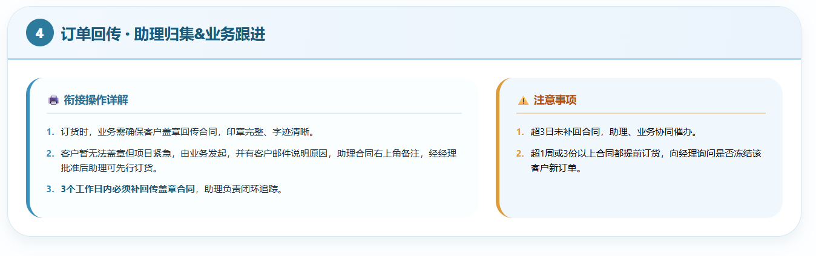

Slide 11
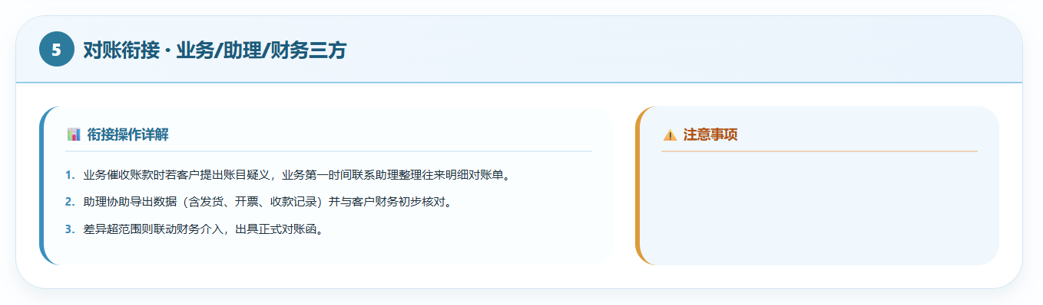

Slide 12
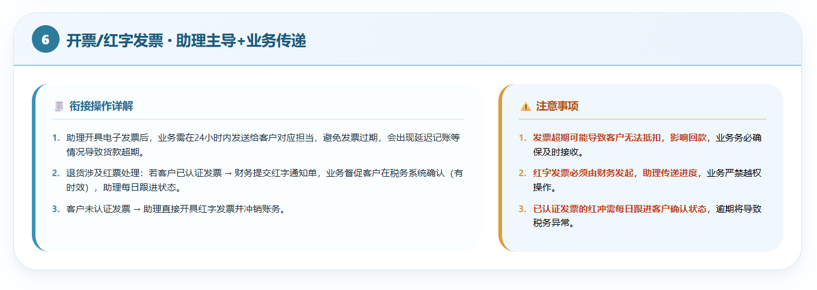

Slide 13
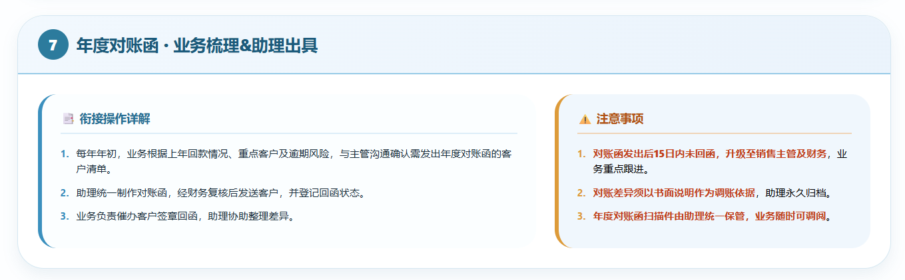

Slide 14
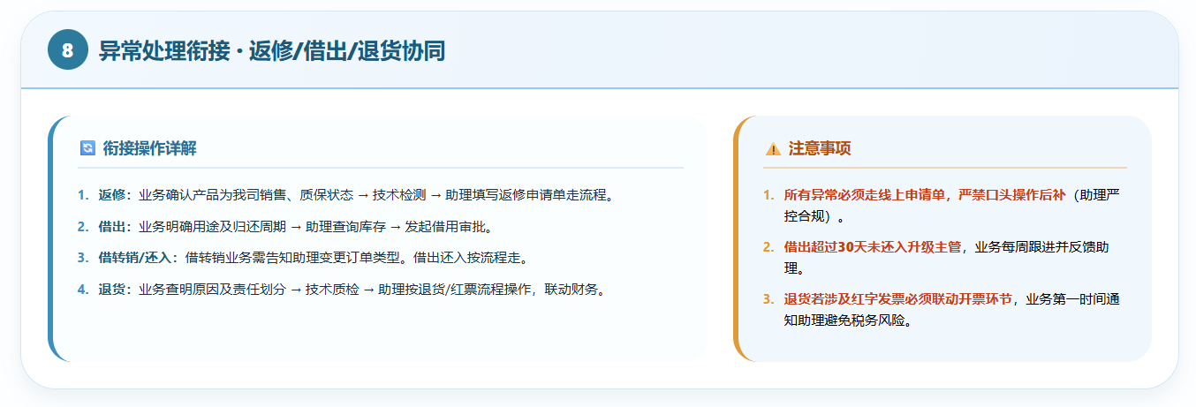

Slide 15
润锋科技
RUNFENGKEJI
谢谢您的观看
WORK SUMMARY REPORT
Suitable for company promotion, product introduction, development plan, business financing, etc. product introduction, development plan, business financing, etc.
培训人：尹正伟 2026.3.31

